Slide 1
Software Design Patterns
<SDML>
Department of Computer Science
Kent State University

Slide 2
Background₁
Search for recurring successful designs – emergent designs from practice (via trial and error)
Supporting higher levels of reuse (i.e., reuse of designs) is quite challenging
Described in Gama, Helm, Johnson, Vlissides 1995 (i.e., “gang of 4 book”)
Based on work by Christopher Alexander (an Architect) on building homes, buildings and towns.

Slide 3
Background₂
Design patterns represent solutions to problems that arise when developing software within a particular context. E.g., problem/solution pairs within a given context
Describes recurring design structures
Describes the context of usage

Slide 4
Background₃
Patterns capture the static and dynamic structure and collaboration among key participants in software designs
Especially good for describing how and why to resolve nonfunctional issues
Patterns facilitate reuse of successful software architectures and designs.

Slide 5
Origins of Design Patterns
“Each pattern describes a problem which occurs over and over again in our environment and then describes the core of the solution to that problem, in such a way that you can use this solution a million times over, without ever doing it in the same way twice”
Christopher Alexander, A Pattern Language, 1977
Context: City Planning and Building architectures

Slide 6
Elements of Design Patterns
Design patterns have four essential elements:
  Pattern name
  Problem
  Solution
  Consequences

Slide 7
Pattern Name
A handle used to describe:
  a design problem
  its solutions
  its consequences
Increases design vocabulary
Makes it possible to design at a higher level of abstraction
Enhances communication
“The Hardest part of programming is coming up with good variable [function, and type] names.”

Slide 8
Problem
Describes when to apply the pattern
Explains the problem and its context
May describe specific design problems and/or object structures
May contain a list of preconditions that must be met before it makes sense to apply the pattern

Slide 9
Solution
Describes the elements that make up the
  design
  relationships
  responsibilities
  collaborations
Does not describe specific concrete implementation
Abstract description of design problems and how the pattern solves it

Slide 10
Consequences
Results and trade-offs of applying the pattern
Critical for:
  evaluating design alternatives
  understanding costs
  understanding benefits of applying the pattern
Includes the impacts of a pattern on a system’s:
  flexibility
  extensibility
  portability

Slide 11
Design Patterns are NOT
Designs that can be encoded in classes and reused as is (i.e., linked lists, hash tables)
Complex domain-specific designs (for an entire application or subsystem)
They are:
  “Descriptions of communicating objects and classes that are customized to solve a general design problem in a particular context.”

Slide 12
Where They are Used
Object-Oriented programming languages [and paradigm] are more amenable to implementing design patterns
Procedural languages: need to define
  Inheritance
  Polymorphism
  Encapsulation

Slide 13
Describing Design Patterns
Graphical notation is generally not sufficient
In order to reuse design decisions the alternatives and trade-offs that led to the decisions are critical knowledge
Concrete examples are also important
The history of the why, when, and how set the stage for the context of usage

Slide 14
Design Patterns
Describe a recurring design structure
  Defines a common vocabulary
  Abstracts from concrete designs
  Identifies classes, collaborations, and responsibilities
  Describes applicability, trade-offs, and consequences

Slide 15
Example: Stock Quote Service
Real time
Market Data
Feed
Stock Quotes
Customer
Customer
Customer
Customer
Customer
Observers

Slide 16
Observer Pattern
Intent:
  Define a one-to-many dependency between objects so that when one object changes state, all its dependents are notified and updated automatically
Key forces:
  There may be many observers
  Each observer may react differently to the same notification
  The subject should be as decoupled as possible from the observers to allow observers to change independently of the subject

Slide 17
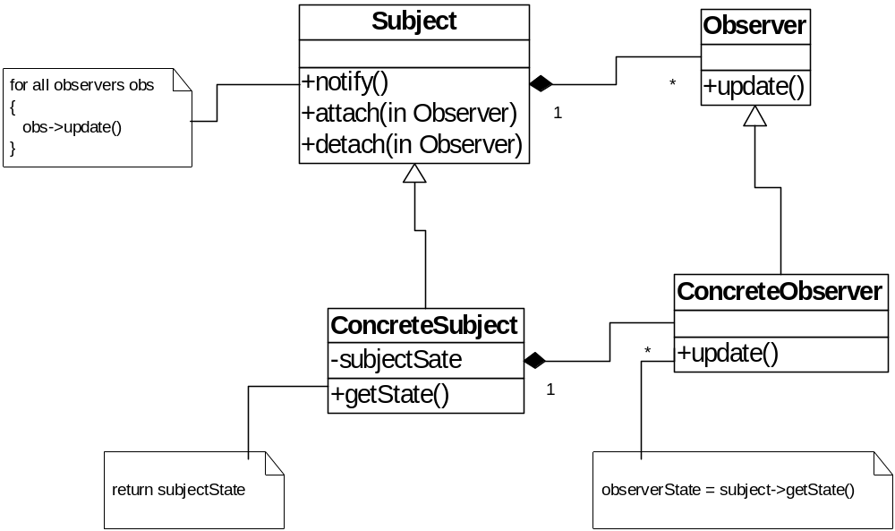
Structure of Observer Pattern

Slide 18
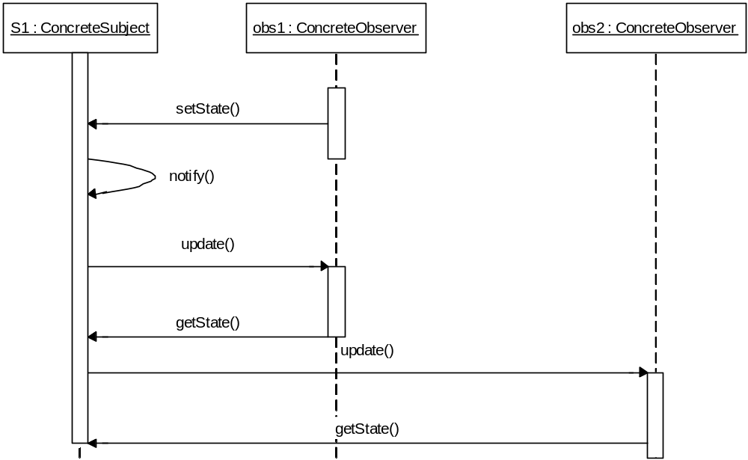
Collaborations in Observer Pattern

Slide 19
Design Pattern Descriptions
Name and Classification: Essence of pattern
Intent: What it does, its rationale, its context
AKA: Other well-known names
Motivation: Scenario illustrates a design problem
Applicability: Situations where pattern can be applied
Structure: Class and interaction diagrams
Participants: Objects/classes and their responsibilities
Collaborations: How participants collaborate
Consequences: Trade-offs and results
Implementation: Pitfalls, hints, techniques, etc.
Sample Code
Known Uses: Examples of pattern in real systems
Related Patterns: Closely related patterns

Slide 20
Types of Patterns
Creational patterns:
  Deal with initializing and configuring classes and objects
Structural patterns:
  Deal with decoupling interface and implementation of classes and objects
  Composition of classes or objects
Behavioral patterns:
  Deal with dynamic interactions among societies of classes and objects
  How they distribute responsibility

Slide 21
Creational Patterns
Abstract Factory:
  Factory for building related objects
Builder:
  Factory for building complex objects incrementally
Factory Method:
  Method in a derived class creates associates
Prototype:
  Factory for cloning new instances from a prototype
Singleton:
  Factory for a singular (sole) instance

Slide 22
Structural Patterns
Adapter:
  Translator adapts a server interface for a client
Bridge:
  Abstraction for binding one of many implementations
Composite:
  Structure for building recursive aggregations
Decorator:
  Decorator extends an object transparently
Facade:
  Simplifies the interface for a subsystem
Flyweight:
  Many fine-grained objects shared efficiently.
Proxy:
  One object approximates another

Slide 23
Behavioral Patterns
Chain of Responsibility:
  Request delegated to the responsible service provider
Command:
  Request is first-class object
Iterator:
  Aggregate elements are accessed sequentially
Interpreter:
  Language interpreter for a small grammar
Mediator:
  Coordinates interactions between its associates
Memento:
  Snapshot captures and restores object states privately

Slide 24
Behavioral Patterns (cont.)
Observer:
  Dependents update automatically when subject changes
State:
  Object whose behavior depends on its state
Strategy:
  Abstraction for selecting one of many algorithms
Template Method:
  Algorithm with some steps supplied by a derived class
Visitor:
  Operations applied to elements of a heterogeneous object structure

Slide 25
Design Pattern Space
Purpose
Creational
Structural
Behavioral
Scope
Class
Factory method
Adapter (class)
Interpreter
Template method
Object
Abstract factory
Builder
Prototype
Singleton
Adapter (object)
Bridge
Composite
Decorator
Façade
Flyweight
Proxy
Chain of responsibility
Command
Iterator
Mediator
Memento
Observer
State
Strategy
Visitor

Slide 26
Categorization Terms
Scope is the domain over which a pattern applies
  Class Scope: relationships between base classes and their subclasses (static semantics)
  Object Scope: relationships between peer objects
Some patterns apply to both scopes.

Slide 27
Class::Creational
Abstracts how objects are instantiated
Hides specifics of the creation process
May want to delay specifying a class name explicitly when instantiating an object
Just want a specific protocol

Slide 28
Example
Use Factory Method to instantiate members in base classes with objects created by subclasses
Abstract Application class: create application-specific documents conforming to a particular Document type
Application instantiates these Document objects by calling the factory method DoMakeDocument
Method is overridden in classes derived from Application
Subclass DrawApplication overrides DoMakeDocument to return a DrawDocument object

Slide 29
Class:: Structural
Use inheritance to compose protocols or code
Example:
  Adapter Pattern: makes one interface (Adaptee’s) conform to another
  Gives a uniform abstraction of different interfaces
  Class Adapter inherits privately from an Adaptee class
  Adapter then expresses its interface in terms of the Adaptee’s.

Slide 30
Class:: Behavioral
Captures how classes cooperate with their subclasses to satisfy semantics.
Example:
Template Method: defines algorithms step by step.
Each step can invoke an abstract method (that must be defined by the subclass) or a base method.
Subclass must implement specific behavior to provide required services

Slide 31
Object Scope
Object Patterns all apply various forms of non-recursive object composition.
Object Composition: most powerful form of reuse
Reuse of a collection of objects is better achieved through variations of their composition, rather than through sub classing.

Slide 32
Object:: Creational
Abstracts how sets of objects are created
Example:
Abstract Factory: create “product” objects through generic interface
  Subclasses may manufacture specialized versions or compositions of objects as allowed by this generic interface
User Interface Toolkit: 2 types of scroll bars (Motif and Open Look)
  Don’t want to hard-code specific one; an environment variable decides
Class Kit:
  Encapsulates scroll bar creation (and other UI entities);
  An abstract factory that abstracts the specific type of scroll bar to instantiate
  Subclasses of Kit refine operations in the protocol to return specialized types of scroll bars.
  Subclasses MotifKit and OpenLookKit each have scroll bar operation.

Slide 33
Object:: Structural
Describe ways to assemble objects to realize new functionality
  Added flexibility inherent in object composition due to ability to change composition at run-time
  not possible with static class composition
Example:
  Proxy: acts as convenient surrogate or placeholder for another object.
    Remote Proxy: local representative for object in a different address space
    Virtual Proxy: represent large object that should be loaded on demand
    Protected Proxy: protect access to the original object

Slide 34
Object:: Behavioral
Describes how a group of peer objects cooperate to perform a task that can be carried out by itself.
Example:
Strategy Pattern: objectifies an algorithm
Text Composition Object: support different line breaking algorithms
  Don’t want to hard-code all algs into text composition class/subclasses
Objectify different algs and provide them as Compositor subclasses (contains criteria for line breaking strategies)
Interface for Compositors defined by Abstract Compositor Class
  Derived classes provide different layout strategies (simple line breaks, left/right justification, etc.)
Instances of Compositor subclasses couple with text composition at run-time to provide text layout
Whenever text composition has to find line breaks, forwards the responsibility to its current Compositor object.

Slide 35
When to Use Patterns
Solutions to problems that recur with variations
  No need for reuse if problem only arises in one context
Solutions that require several steps:
  Not all problems need all steps
  Patterns can be overkill if solution is a simple linear set of instructions
Solutions where the solver is more interested in the existence of the solution than its complete derivation
  Patterns leave out too much to be useful to someone who really wants to understand
  They can be a temporary bridge

Slide 36
What Makes it a Pattern?
A Pattern must:
  Solve a problem and be useful
  Have a context and can describe where the solution can be used
  Recur in relevant situations
  Provide sufficient understanding to tailor the solution
  Have a name and be referenced consistently

Slide 37
Benefits of Design Patterns
Design patterns enable large-scale reuse of software architectures and also help document systems
Patterns explicitly capture expert knowledge and design tradeoffs and make it more widely available
Patterns help improve developer communication
Pattern names form a common vocabulary
Patterns help ease the transition to OO technology

Slide 38
Drawbacks to Design Patterns
Patterns do not lead to direct code reuse
Patterns are deceptively simple
Teams may suffer from pattern overload
Patterns are validated by experience and discussion rather than by automated testing
Integrating patterns into a software development process is a human-intensive activity.

Slide 39
Suggestions for Effective Use
Do not recast everything as a pattern
  Instead, develop strategic domain patterns and reuse existing tactical patterns
Institutionalize rewards for developing patterns
Directly involve pattern authors with application developers and domain experts
Clearly document when patterns apply and do not apply
Manage expectations carefully.

Slide 40
References
Gama, Helm, Johnson, Vlissides, Design Patterns Elements of Reusable Object-Oriented Software, Addison Wesley, 1995
B. Cheng – Michigan State University

Slide 41
Web Resources
http://www.dofactory.com/
http://hillside.net/patterns/

